Slide 1

BDM Capstone Project
OPTIMIZING SALES FORECASTING
& INVENTORY MANAGEMENT
for Mr. Pizza Shop
Lakshika Dev | Roll No: 22F3000223
22f3000223@ds.study.iitm.ac.in
IITM Online BS Degree Program,
Indian Institute of Technology, Madras, Chennai
Tamil Nadu, India, 600036

Slide 2
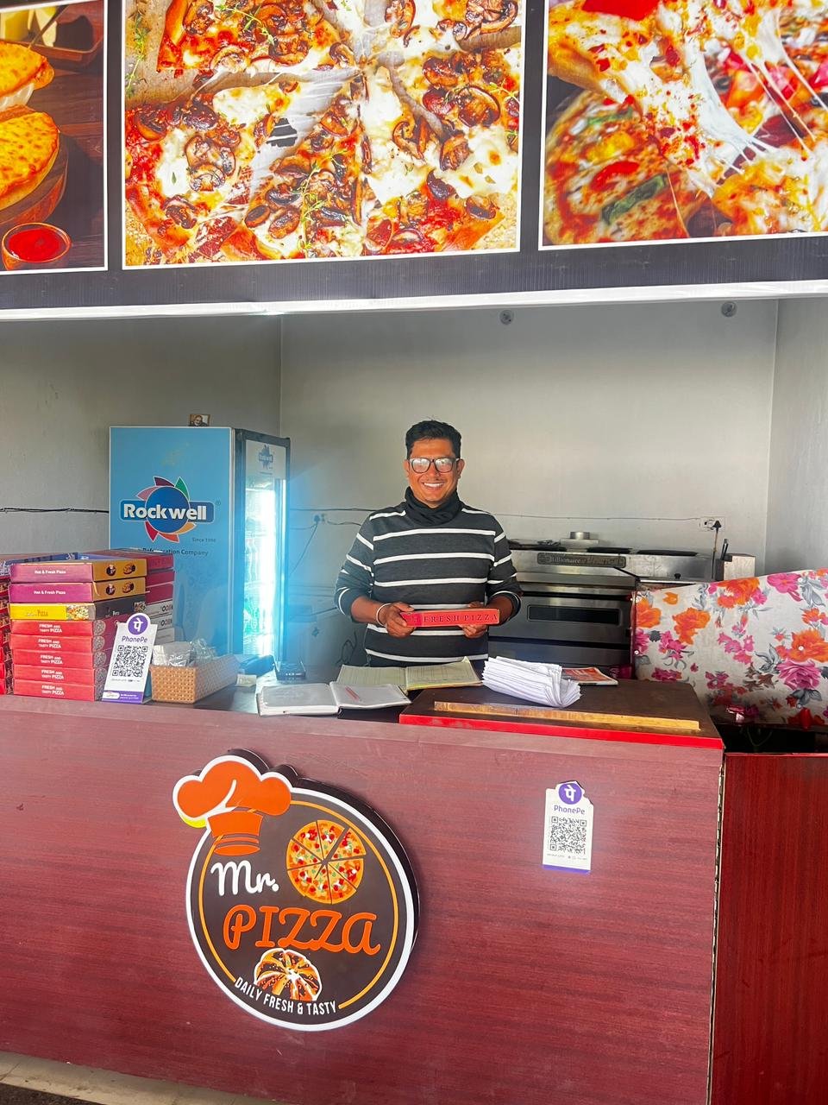
Project Overview
Mr. Pizza is a single-operator B2C food outlet in Kathgodam, Uttarakhand (Est. 2023). Run entirely by Mr. Prakash Singh Danu. 54 menu items, 9 categories, walk-in + Zomato. Primary data: owner's handwritten sales notebook.
Three problems identified through owner interviews:
P1 Cannot forecast demand → wastage + stockouts P2 No inventory system → 54 items managed by guesswork P3 No pattern insight → Tuesday = only 1/3 of Sunday revenue
📈 P1 — 4-Week Moving Average (MA4) · Time series analysis of seasonal demand
📦 P2 — ABC Inventory Classification · Pareto-based 3-tier stocking priority
📅 P3 — Day-of-Week Pattern Analysis · Identify peak/trough days for promotions
Mr. Prakash Singh Danu · Owner, Mr. Pizza · Kathgodam, Uttarakhand

Slide 3
Data Collection & Preprocessing
🧾 Sales Transactions Dataset
📋 Item Master / Lookup Sheet
⚙️ Derived Feature Engineering
▸ 997 line-item records
▸ 47 unique menu items
▸ Day column: =TEXT(date,'dddd')
▸ 139 trading days
▸ Canonical price list (VLOOKUP)
▸ Line Total = Qty × Unit Price
▸ Sep 2023 – Jan 2024
▸ 9 product categories
▸ Month column for aggregation
▸ Source: Handwritten notebook
▸ Size variants: S / M / L
▸ Week Number for MA4 series
▸ Fields: Date · Item · Size · Qty · Price
▸ Unit price range: ₹30 – ₹579
▸ Daily Revenue cross-verification
★ Primary data — collected in-person
★ Feature: VLOOKUP auto-fill prices
★ Cross-check: 0% discrepancy found
Data Cleaning Process
1. Manual digitization
2. Name standardisation
('Thandoori'→'Tandoori')
3. Outlier flagged
(₹7,425 catering day)
4. Cross-verified vs.
owner's daily totals
5. 0% discrepancy
confirmed
→
→
→
→

Slide 4
P1 — Sales Forecasting: MA4 Time Series Analysis
4-Week Moving Average Formula:
MA4(t) = [R(t) + R(t−1) + R(t−2) + R(t−3)] ÷ 4
Where R(t) = total revenue in week t.
MA4 smooths week-to-week noise and reveals the underlying seasonal trend. Computed in Google Sheets using AVERAGE() across a 4-cell rolling window.
Seasonal Adjustment Factors:
S(m) = [Actual(m) − MA4(m)] ÷ MA4(m) × 100%
S(December) ≈ −14.4% → reduce MA4 by 15%
S(January) ≈ +16.5% → increase MA4 by 20%
25.4% decline
Sep → Dec (₹8,623 – 25% drop)
+36.1% Jan recovery
₹34,443 — highest month
Procurement rule:
MA4 every Friday
Why MA4, not ARIMA?
Only 5 months (20 weekly points) — ARIMA needs 2+ years. MA4 is also computable by the owner in a notebook in < 5 minutes, with zero software.
✅ Practical Rule: Every Friday, average last 4 weeks' revenue = next week's procurement target. Apply –15% in Nov–Dec | +20% in January

Slide 5
P3 — Customer Patterns: Day-of-Week Revenue Analysis
☀️ SUNDAY PEAK
₹36,600 — 24.0% of weekly revenue
WHY: Rest day in India → families dine out, Zomato spikes. 2.8× more than Tuesday. Stockout = ~₹5,600 lost.
📉 TUESDAY TROUGH
₹13,104 — 8.6% of weekly revenue
WHY: Mid-week workday, no social trigger. Structural unused capacity. Fix: Tuesday Kulhad Pizza combo.
📊 WEEKEND PREMIUM
78% higher revenue/day vs weekdays
Sat+Sun = 41.6% of revenue from just 2 days. High asset AND high stockout risk concentration.
❓ WEDNESDAY SURPRISE
₹20,729 — beats Thu & Fri
local Kathgodam market day.
📌 RECOMMENDATION: Tuesday Combo — Kulhad Pizza + Cold Drink at ₹120 (~10% off combined ₹134). Promoted via handwritten sign.
Target: +20% Tuesday revenue within 8 weeks → ~₹2,600/month incremental revenue.

Slide 6
P2 — Inventory Management: ABC Classification
Formula: Share(i) = R(i) ÷ R(total) × 100% | Cumulative Share(k) = Σ Share(i) | Class A ≤ 70% · Class B: 70–90% · Class C: > 90%
Class | # Items | Key Items | Units Sold | Revenue (₹) | % Revenue | Stocking Rule
A | 12 | Mix Veg Margharita · Kulhad Pizza · Cheese N Corn · Onion Cheese · Paneer Pizza · Tandoori Pizza + 6 more | 665 | ₹72,605 | 47.5% | Always in stock; 2-day buffer on 7 core ingredients
B | 4 | Veg Burger · Spicy Mix Veg Pizza · Overloaded Cheese Pizza · Veg Cheese Burger | 311 | ₹22,661 | 14.8% | Weekly review; reorder at 1-day supply
C | 37 | Hot Dog · Bread · Add-ons · Desserts · Beverages · remaining 32 items | 777 | ₹57,413 | 37.6% | Order on demand ONLY — stop pre-stocking
🔑 7 shared core ingredients cover ALL Class A items: Cheese · Pizza Base · Tomato Sauce · Capsicum · Corn · Onion · Paneer
₹72,605
47.5%
37 items
Class A revenue
protected from stockout
Revenue from top
12 pizza items only
Class C — stop
pre-stocking immediately

Slide 7
ABC Analysis: Top Revenue Items & ABC-XYZ Extension
Why ABC-XYZ Would Be Better
ABC classifies by revenue value only. XYZ adds demand variability (via CV): X = Stable demand (CV < 10%) Y = Variable demand (CV 10–25%) Z = Erratic demand (CV > 25%) A-Z item = high revenue + unpredictable → needs a large safety stock buffer Why not done: Only 5 months → too few data points per item for reliable CV. First enhancement with 12+ months: ABC-XYZ + Holt-Winters forecasting.
📌 Top 2 items (Mix Veg Margharita + Kulhad Pizza) = ₹34,345 = 22.5% of total revenue from just 2 of 54 items.
Kulhad Pizza = 164 units (highest volume) at ₹99 — the entry-point product anchoring repeat visits. Never let this stock out.

Slide 8
Revenue Analysis: Category Breakdown & Key Descriptives
79.8%
₹1,099
Pizza's share of
total revenue
Mean daily
revenue
₹923
₹853
Median daily
revenue
Std deviation
(high variability!)
Distribution Shape
ℹ️ Revenue alone overstates low-volume, high-price items.
Volume leaders: Kulhad Pizza (164 units) · Mix Veg Margharita (140 units) · Cheese N Corn (105 units).
Price range: ₹30 (add-on) → ₹579 (large family pizza). Both revenue AND volume should drive stocking decisions.
Mean (₹1,099) > Median (₹923) → right-skewed distribution. Caused by catering event outliers (max ₹7,425). SD = 78% of mean → extreme day-to-day variability. This justifies using MA4 smoothing over a flat average for procurement decisions.

Slide 9
SMART Recommendations — Mapped to P1 · P2 · P3
P1
1. Every Friday: MA4 = avg of last 4 weeks' revenue → next week's procurement target (< 5 min, no software)
2. Seasonal adjustments: Oct –10% · Nov –12% · Dec –15% · Jan +20%
📈 Forecasting Fix
3. Expected: Reduce winter wastage by ₹3,000–5,000/month
1. Class A (12 items): Always in stock with 2-day buffer on 7 core ingredients (Cheese, Base, Sauce, Capsicum, Corn, Onion, Paneer)
P2
2. Class C (37 items): Stop pre-stocking immediately — order only when customer requests
📦 Inventory Fix
3. Expected: Zero Class A stockouts · Protect ₹72,605 revenue per 5-month period
1. Tuesday Combo: Kulhad Pizza + Cold Drink at ₹120 (~10% off) — handwritten sign at entrance within 1 month
P3
2. Kulhad Pizza (164 units, highest volume) available 7 days/week without exception — retention anchor
🎯 Retention Fix
3. Begin WhatsApp contact collection; build 100+ list in 3 months · Expected: +₹2,600/month from Tuesday alone

Slide 10
Limitations, Future Scope & Conclusion
⚠ 5-month data only
⚠ No customer identification
Cannot do full seasonal decomposition or ARIMA (needs 2+ years). Seasonal factors derived from just 1 cycle.
Anonymous walk-ins → CLV, repeat visit rate, cohort retention all uncomputable. POS system needed.
⚠ Incomplete purchase records
⚠ ABC without XYZ
Only cheese, milk, toppings billed. No wheat/flour data → COGS and gross margin per item unavailable.
Demand variability not measured. With 12+ months, CV analysis would enable ABC-XYZ and proper safety stock sizing.
Future Scope: ABC-XYZ with 12+ months · Holt-Winters / seasonal ARIMA · Free POS app (Vyapar / OkCredit) · WhatsApp CRM · Full COGS & profit-based ABC classification
79.8%
41.6%
22.5%
~₹21K
Revenue from
Pizza alone
Revenue from
weekend 2 days
Revenue from
top 2 items
Estimated 5-month
impact of recs

